Slide 1
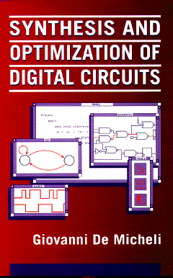


Timing Issues in Multi-level Logic Optimization
Giovanni De Micheli
Integrated Systems Centre
EPF Lausanne
This presentation can be used for non-commercial purposes as long as this note and the copyright footers are not removed
© Giovanni De Micheli – All rights reserved

Slide 2
Module 1
Objectives:
  Timing verification:
  Delay modeling
  Critical paths
  The false path problem

Slide 3
Timing verification and optimization
Verification:
  Check that a circuit runs at speed
    Satisfies I/O delay constraints
    Satisfies cycle-time constraints
Optimization:
  Minimum delay
    ( subject to area constraints )
  Minimum area
    Subject to delay constraints

Slide 4
Delay modeling
Gate delay modeling:
  Straightforward for bound networks
  Approximations for unbound networks
Network delay modeling:
  Compute signal propagation
    Topological methods
    Logic/topological methods (false paths)

Slide 5
Gate delay modeling unbound networks
Virtual gates:
  Logical expressions
Stage delay model:
  Unit delay per vertex
Refined models:
  Depending on fanout

Slide 6
Network delay modeling
For each vertex v_{i}
Propagation delay d_{i} :
  I/O propagation delays are usually zero
Data-ready time t_{i} :
  Input data-ready time denote when inputs are available
  Computed elsewhere by forward traversal
  t_{i} = d_{i} + max_{j} t_{j} s.t. (v_{j},v_{i}) ε E

Slide 7
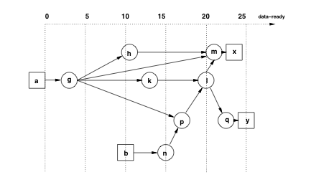
Example
Propagation delays:
  d_{g} = 3; d_{h} = 8; d_{m} = 1; d_{k} = 10; d_{l} = 3
  d_{n} = 5; d_{p} = 2; d_{o} = 2; d_{x} = 2; d_{y} = 3

Slide 8
Network delay modeling
For each vertex v_{i} :
Required data-ready time t_{i} :
  Specified at the primary outputs
  Computed elsewhere by backward traversal
  t_{i} = min_{j} t_{j} - d_{j} s.t. (v_{i} ,v_{j}) ε E
Slack s_{i} :
  Difference between required and actual data-ready times
  s_{i} = t_{j} - t_{i}

Slide 9
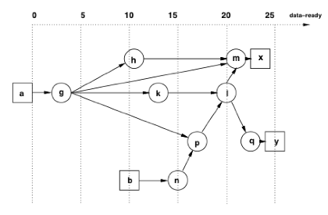
Example
Required data-ready times:
  t_{x}= 25 and t_{y}= 25

Slide 10
Example
s_{x} = 2; s_{y} = 0
t_{m}= 25 - 2 = 23; s_{m} = 23 - 21 = 2
t_{q}= 25 - 2 = 22; s_{q} = 22 - 22 = 0
t_{l} = min {23 - 1;22 - 2} = 20; s_{l} = 20 - 20 = 0
t_{b}= 23 - 1 = 22; s_{h} = 22 - 11 = 11
t_{k}= 20 - 3 = 17; s_{k} = 17 - 13 = 4
t_{p}= 20 - 3 = 17; s_{p} = 17 - 17 = 0
t_{n}= 17 - 2 = 15; s_{n} = 15 - 15 = 0
t_{b}= 15 - 5 = 10; s_{b} = 10 - 10 = 0
t_{g}= min {22 - 11;17 - 10; 17 - 2} = 7; s_{g} = 7 - 3 = 4
t_{a}= 7 - 3 = 4; s_{a} = 4 - 0 = 4

Slide 11
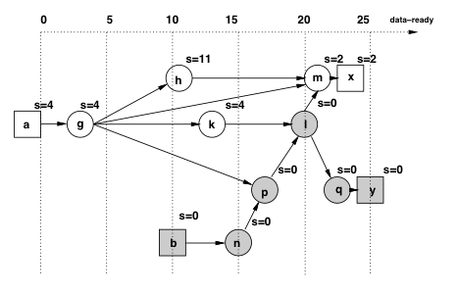
Example

Slide 12
Topological critical path
Assume topologic computation of :
  Data-ready by forward traversal
  Required data-ready by backward traversal
Topological critical path :
  Input/output path with zero slacks
  Any increase in the vertex propagation delay affects the output data-ready time
A topological critical path may be false:
  No event can propagate along that path

Slide 13
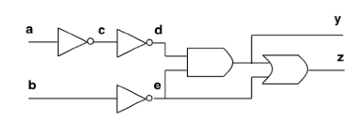
Example
All gates have unit delay
All inputs ready at time 0
Longest topological path : (v_{a}, v_{c}, v_{d}, v_{y}, v_{z}) :
  Path delay: 4 units
Critical true path: (v_{a}, v_{c}, v_{d}, v_{y}) :
  Path delay: 3 units

Slide 14
Sensitizable paths
A path in a logic network is sensitizable if an event can propagate from its tail to its head
A critical path is a sensitizable path of maximum weight
Only sensitizable paths should be considered
Non-sensitizable paths are false and can be discarded

Slide 15
Sensitizable paths
Path:
  Ordered set of vertices
Inputs to a vertex:
  Direct predecessors
Side-inputs of a vertex:
  Inputs not on the path

Slide 16
Dynamic sensitization condition
Path: P = (v_{xo}, v_{x1}, … , v_{xm} )
An event propagates along P if :
∂f_{xi} / ∂x_{i-1} = 1 , i = 1, 2, …, m
Remarks :
  Boolean differences are function of the side-inputs and values on the side-inputs may change
  Boolean differences must be true at the time that the event propagates

Slide 17
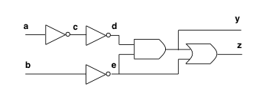
Example
Path: (v_{a}, v_{c}, v_{d}, v_{y}, v_{z})
  ∂f_{y} / ∂d = e = 1 at time 2
  ∂f_{x} / ∂y= e’ = 1 at time 3
Not dynamically sensitizable because e settles at time 1

Slide 18
Static sensitization
Simpler, weaker model
We neglect the requirement on when the Boolean differences must be true to propagate an event
There is an assignment of primary inputs c such that:
∂f_{xi}( c ) / ∂x_{i-1} = 1 i=1,2, …, m
May lead to underestimate delays

Slide 19
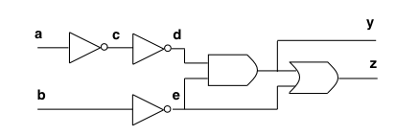
Example
Not statically sensitizable

Slide 20
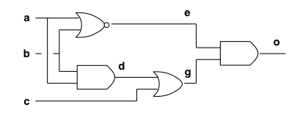
Example
All gates have unit delay
Topological critical paths:
  {(v_{a}, v_{d}, v_{g}, v_{o}); (v_{b}, v_{d}, v_{g}, v_{o}) }
  Path delay : 3
  Not statically sensitizable
Other path:
  (v_{a}, v_{e}, v_{o})
  Path delay: 2
Assume:
  c = 0 and a, b dropping from 1 to 0
  Event propagates to output !!!

Slide 21
Modes for delay computation
Transition mode:
  Variables assumed to hold previous values
    Model circuit node capacitances
  Two test vectors are needed
Floating mode:
  Circuit is assumed to be memoryless
    Variables have unknown value until set by input test vector
  Need only one test vector

Slide 22
Modes for delay computation
Floating mode delay computation is simpler than transition mode computation
Floating mode is a pessimistic approach
Floating mode is more robust:
  Transition mode may not have the monotone speed-up property

Slide 23
Monotone speed-up property
Propagation delays are upper bounds:
  What happens if gates are faster than expected?
We must insure that speeding-up a gate does not slow-down the circuit:
  Topological critical paths are robust
  What about dynamically sensitizable paths in transition mode?

Slide 24
Example
Propagation delay: 2 units
Shaded gate: 3 units and 1 unit

Slide 25
Static co-sensitization
Assumption:
  Circuit modeled by AND, OR, INV gates
  INV are irrelevant to the analysis
  Floating mode
Controlling values:
  0 for AND gate
  1 for OR gate
Gate has controlled value

Slide 26
Static co-sensitization
Path: P = (v_{xo}, v_{x1}, ……. , v_{xm} )
A vector statically co-sensitizes a path to 1 (or to 0) if :
  x_{m} = 1 (or 0) and
  v_{xi-1} has a controlling value whenever v_{xi} has a controlled value
Necessary condition for a path to be true

Slide 27
False path detection test
For all input vectors, one of the following is true:
  (1) A gate is controlled and
    the path provides a non-controlling value
    a side-input provides a controlling value
  (2) A gate is controlled and
    The path and a side-input have controlling values
    The side-input presents the controlling value first
  (3) A gate is not controlled and
    A side-input presents the non-controlling value last

Slide 28
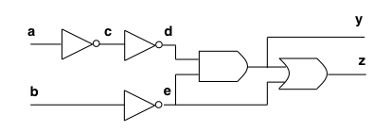
Example
Path: (v_{a}, v_{c}, v_{d} , v_{y}, v_{z})
For a = 0, b = 0 :
  Condition (1) occurs at the OR gate
For a = 0, b = 1 :
  Condition (2) occurs at the AND gate
For a = 1, b = 0 :
  Condition (2) occurs at the OR gate
For a = 1, b = 1 :
  Condition (1) occurs at the AND gate

Slide 29
Important problems
Check if circuit works at speed t :
  Verify that all true paths are faster than t
  Show that all paths slower than t are false
Compute groups of false paths
Compute critical true path:
  Binary search for values of t
  Show that all paths slower that t are false

Slide 30
Module 2
Objectives:
  Algorithms for timing optimization
  Favorable logic transformations

Slide 31
Algorithms for delay minimization
Alternate:
  Critical path computation
  Logic transformation on critical vertices
Consider quasi critical paths:
  Paths with near-critical delay
  Small slacks

Slide 32
Algorithms for delay minimization
REDUCE_DELAY ( G_{n} (V,E) , ε){
repeat {
  Compute critical paths and critical delay τ
  Set output required data-ready times to τ
  Compute slacks
  U = vertex subset with slack lower than ε
  W = select vertices in U
  Apply transformations to vertices W
  } until (no transformation can reduce τ )
  }

Slide 33
Transformation for delay reduction
Reduce propagation delay
Reduce dependencies from critical inputs
Favorable transformation:
  Reduces local data-ready time
  Any data-ready time increase at other vertices is bounded by the local slack

Slide 34
Example
Unit gate delay
Transformation:
  Elimination
Always favorable
Obtain several area/delay trade-off points

Slide 35
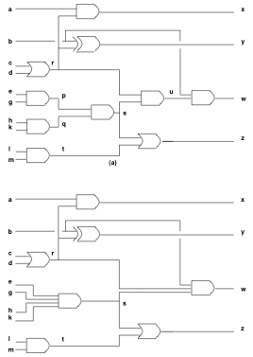
Example
Iteration 1:
eliminate v_{p}, v_{q} . (No literal increase)
Iteration 2:
eliminate v_{u} . (No literal increase)
Iteration 3:
eliminate v_{r}, v_{s}, v_{t} . ( Literal increase)

Slide 36
More refined delay models
Elimination:
  Reduces one stage
  Yields more complex and slower gates
  May slow other paths
Substitution:
  Adds one dependency
  Loads and slows a gate
  May slow other paths

Slide 37
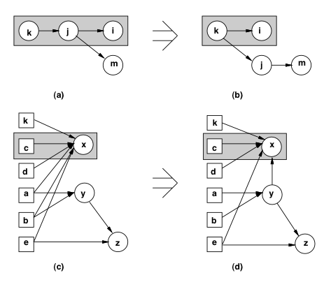
Example

Slide 38
Speed-up algorithm
Determine a subnetwork W of depth d
Collapse subnetwork by elimination
Duplicate vertices with successors outside W:
  Record area penalty
Resynthesize W by timing-driven decomposition
Heuristics:
  Choice of W
  Monitor area penalty and potential speed-up

Slide 39
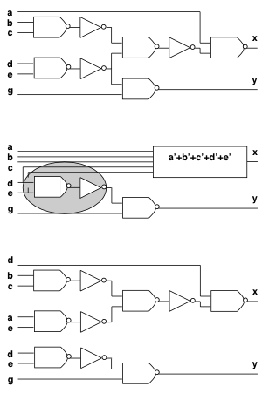
Example
NAND delay = 2
INV delay = 1
All input data-ready are 0,
except = t_{d} = 3

Slide 40
Minimal-area synthesis under delay constraints
Start from timing-feasible network
Minimize area while preserving timing feasibility:
  Use area optimization algorithms
  Monitor delays and slacks
  Reject transformations yielding negative slacks

Slide 41
Making a network timing feasible
Naive approach:
  Mark vertices with negative slacks
  Apply transformations to marked vertices
Redefined approach:
  Transform multiple I/O delay constraints into single constraint by delay padding
  Apply algorithms for CP minimization
  Stop when constraints are satisfied

Slide 42
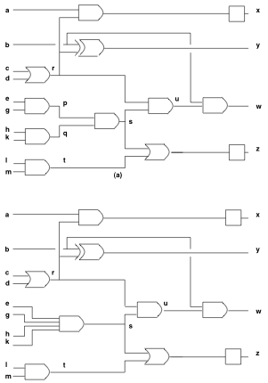
Example
= [2332]^{T}

Slide 43
Summary
Timing optimization is crucial for achieving competitive logic design
Timing optimization problems are hard:
  Detection of critical paths
    Elimination of false paths
  Network transformations

